Slide 1


Automatic staircase light
Guided by :Prof. Jinesh Patolia
:Prof. Miral Desai
Prepared by: Kushang Darbar(18ec017)

Slide 2
Project Description
First of all, the below conditions are checked:
Presence of darkness(LDR status)
Presence of motion(PIR status)
If these conditions are fulfilled, the staircase lights will glow automatically.
If any of these conditions are false, the staircase lights will not glow.

Slide 3
Hardware components
ATMEGA32
Power supply(5V)
LED
AVR-ISP programmer
Resistors(220ohm,100k ohm,10k ohm)
LDR(Light Dependent Resistor)
PIR(Pyroelectric Infrared) sensor
TIP122 transistor

Slide 4
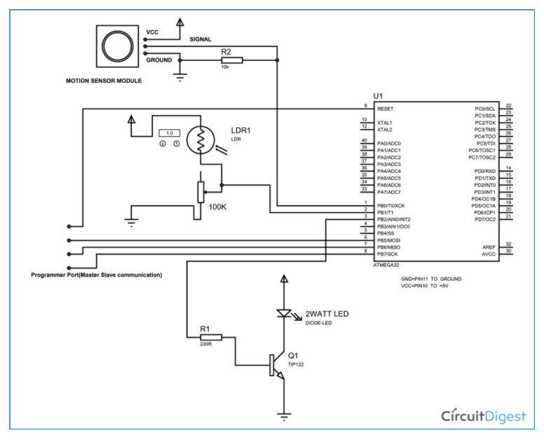
Circuit Diagram

Slide 5
Block Diagram
LDR status(PB1==0)
PIR status(PB==1)
Trigger transistor for power LED
(PB2==1)

Slide 6
Flow chart
Presence of darkness
Detection of motion
Lights On/Off

Slide 7
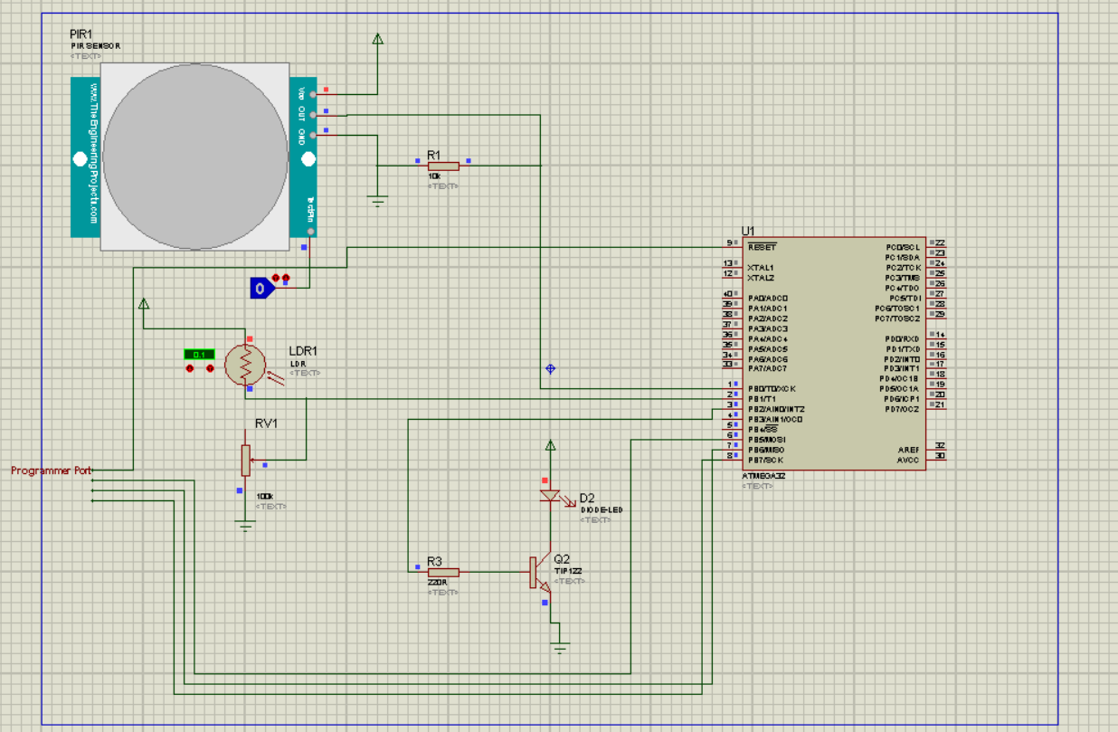
Output(proteus)
1.
PB0==0 & PB1==0
PB2==0

Slide 8
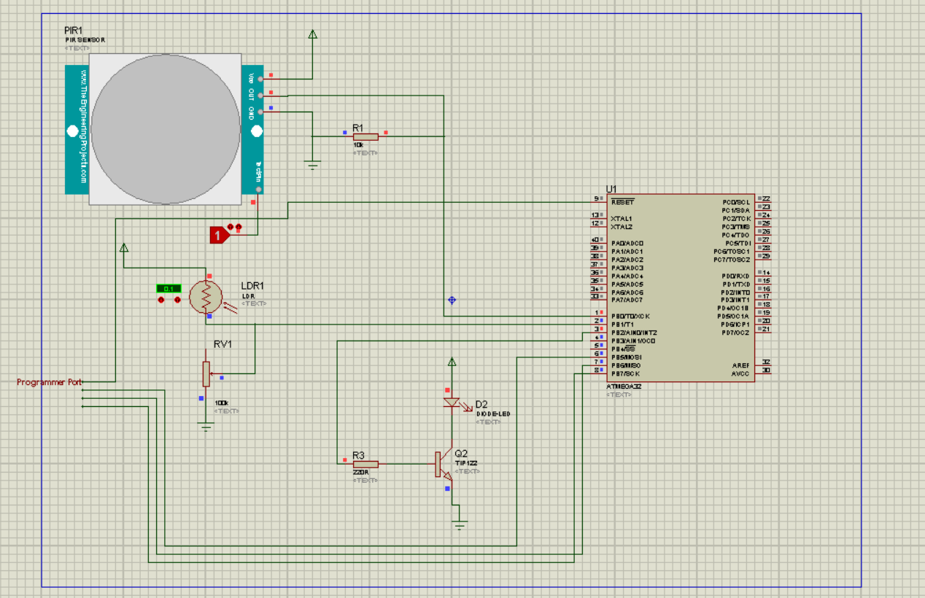
2.
PB0==1 & PB1==0
PB2==1

Slide 9
references
https://circuitdigest.com/microcontroller-projects/automatic-staircase-lighting-using-avr-microcontroller

